Slide 1


Software Systems as Cities:
A Controlled Experiment
speaker:YingJian Xiao

Slide 2
ABSTRACT
Software visualization is a popular program comprehension tech_x0002_nique used in the context of software maintenance, reverse engineering, and software evolution analysis.
We present a controlled experiment for the empirical evaluation of a 3D software visualization approach based on a city metaphor and implemented in a tool called CodeCity.

Slide 3
Contents
01. INTRODUCTION
02. CODECITY IN A NUTSHELL
03. RELATED WORK
04. EXPERIMENTAL DESIGN WISH LIST
05. EXPERIMENTAL DESIGN
06. OPERATION

Slide 4
Contents
07. DATA COLLECTION
08. DATA ANALYSIS
09. RESULTS
10. THREATS TO VALIDITY
11. CONCLUSION

Slide 5
1. INTRODUCTION
1. we detail the experiment design and its operation, reporting on a number of lessons learned regarding the many pitfalls that this type of experiment entails.
2. we discuss the results of the experiment, which show that our approach is a viable alternative to existing non-visual techniques.

Slide 6
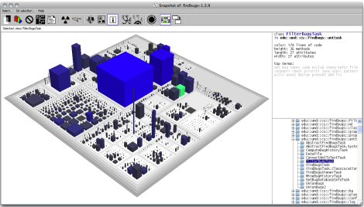
2. CODECITY IN A NUTSHELL
Figure 1: Representation of a software system in CodeCity

Slide 7
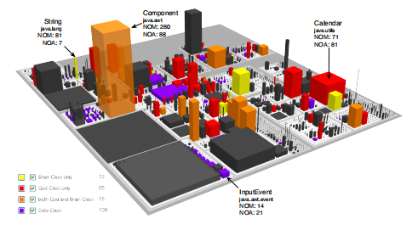
2. CODECITY IN A NUTSHELL
Figure 2: Example of disharmony map (a part of JDK 1.5)

Slide 8
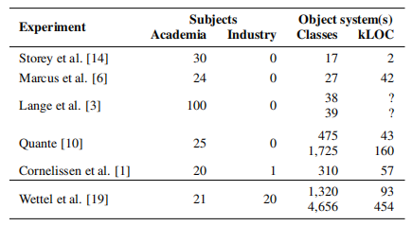
3. RELATED WORK
Table 1: Comparing to the related work

Slide 9
4. EXPERIMENTAL DESIGN WISH LIST
1. Choose a fair baseline for comparison
2. Involve participants from industry.
3. Take into account the range of experience level of the participants.
4. Provide a tutorial of the experimental tool to the participants.
5. Find a set of relevant tasks.
6. Include tasks which may not advantage the tool being evaluated.

Slide 10
4. EXPERIMENTAL DESIGN WISH LIST
7. Limit the time allowed for solving each task.
8. Choose real-world systems.
9. Include more than one subject system in the experimental design.
10. Provide the same data to all participants.
11. Report results on individual tasks
12. Provide all the details needed to make the experiment replicable.

Slide 11
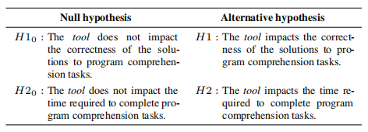
5. EXPERIMENTAL DESIGN
5.1 Research Questions & Hypotheses
Table 2: Null and alternative hypotheses

Slide 12
5. EXPERIMENTAL DESIGN
5.2 Dependent and Independent Variables
Finding a Baseline
Eclipse+ Excel

Slide 13
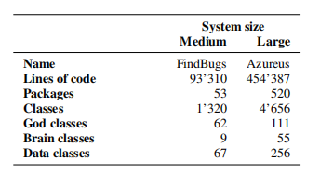
5. EXPERIMENTAL DESIGN
5.2 Dependent and Independent Variables
Object Systems
Table 3: The two object systems

Slide 14
5. EXPERIMENTAL DESIGN
5.3 Controlled Variables
industry
1. background
academy
2. experience level

Slide 15
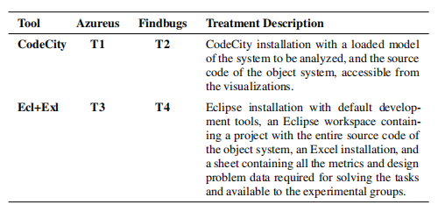
5. EXPERIMENTAL DESIGN
5.4 Treatments
Table 4: Treatments

Slide 16
5. EXPERIMENTAL DESIGN
5.5 Tasks
A1: Look for the term T1 in the names of classes and their attributes and methods, and describe the spread of these classes in the system.
A2.1: Look for the term T1 in the names of classes and their attributes and methods, and describe the spread of these classes in the system.
A2.2: Look for the term T2 in the names of classes and their attributes and methods, and describe the spread of these classes in the system.
A3: Evaluate the change impact of class C by considering its caller classes (classes invoking any of its methods). The assessment is done in terms of both intensity (number of potentially affected classes) and dispersion (how these classes are distributed in the package structure).
A4.1: Find the three classes with the highest number of methods (NOM) in the system.
A4.2: Find the three classes with the highest average number of lines of code per method in the system.

Slide 17
5. EXPERIMENTAL DESIGN
5.5 Tasks
B1.1: Identify the package with the highest percentage of god classes in the system.
B1.2: Identify the god class containing the largest number of methods in the system.
B2.1: Identify the dominant class-level design problem (the design problem that affects the largest number of classes) in the system.
B2.2: Write an overview of the class-level design problems in the system. Describe your most interesting or unexpected observations.

Slide 18
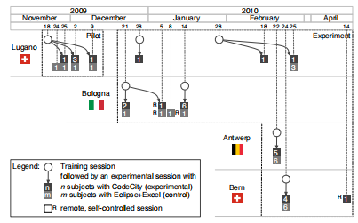
6. OPERATION
Figure 3: The timeline of the experiment

Slide 19
7. DATA COLLECTION
Personal Information
Timing Data
Correctness Data
Participants’ Feedback

Slide 20
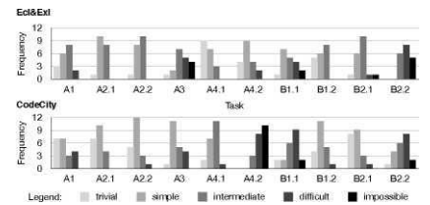
8. DATA ANALYSIS
8.1 Preliminary Data Analysis
Figure 4: Histograms of perceived difficulty per task

Slide 21
8. DATA ANALYSIS
8.2 Outlier Analysis
Before performing our statistical test, we followed the suggestion of Wohlin et al. regarding the removal of outliers caused by exceptional conditions, to allow us to draw valid conclusions from the data.

Slide 22
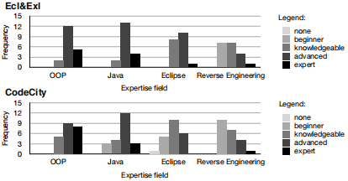
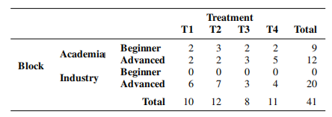
8. DATA ANALYSIS
8.3 Subject Analysis
Table 6: Subject distribution
Figure 5: Subjects’ expertise

Slide 23
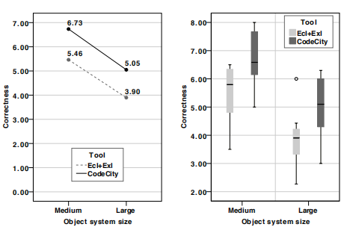
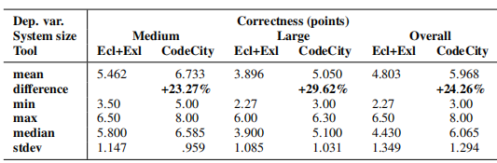
9. RESULTS
9.1 Analysis Results on Correctness
Figure 6: Means and box plots for correctness
Table 7: Descriptive statistics related to correctness

Slide 24
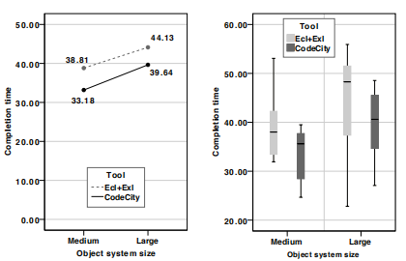
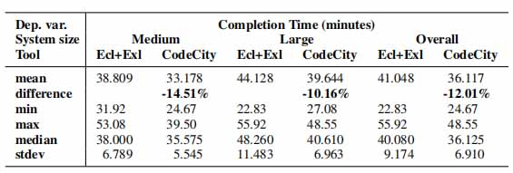
9. RESULTS
9.2 Analysis Results on Completion Time
Figure 6: Means and box plots for correctness
Table 7: Descriptive statistics related to completion time

Slide 25
9. RESULTS
9.3 Result Summary
Correctness：
The data allows us to reject the first null hypothesis H10 in favor of the alternative hypothesis H1, which states that the tool impacts the correctness of the solutions to program comprehension tasks. Overall, CodeCity enabled an increase in correctness of 24.26% over Ecl+Exl. This result is statistically significant.
Completion time：
We can also reject the second null hypothesis H20 in favor of the alternative hypothesis H2, which states that the tool impacts the time required to complete program comprehension tasks. Overall, CodeCity enabled a completion time reduction of 12.01% over Ecl+Exl. This result is statistically significant.

Slide 26
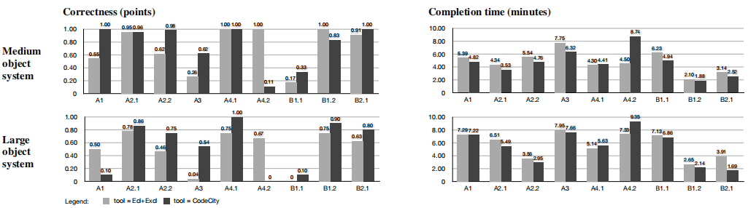
9. RESULTS
9.4 Task Analysis
Figure 8: Average correctness and completion time per task

Slide 27
10. THREATS TO VALIDITY
Internal Validity：
1. Subjects
2. Tasks
3. Baseline
4. Data differences
5. Session differences
6. Training
External Validity：
1. Subjects
2. Tasks
3. Object systems
4. Experimenter effect

Slide 28
11. CONCLUSION
The main result of the experiment is that our approach leads to an improvement, in both correctness (+24%) and completion time (-12%), over the state-of-the-practice exploration tools.

Slide 29
感谢聆听

